Slide 1
Computer Basics
Ch 1.1

Slide 2
Computer Basics: Outline
Computer Components
Programs
Programming Languages and Compilers
Java Byte-Code
Graphics Supplement (FYI)

Slide 3
Computer Components
Computer systems consist:
Hardware: the tangible parts of computer systems.
Software: includes programs - sets of instructions for the computer to follow.
Generally, computers have similar components
Input devices (keyboard, mouse, etc.)
Output devices (display screen, printer, etc.)
A processor
Two kinds of memory (main memory and auxiliary memory).
Notes:
Familiarity with hardware basics helps us understand software
Memory holds
programs
data for the computer to process
the results of intermediate processing.

Slide 4
The Processor
It’s called the CPU (central processing unit):
Control unit (supervises the operation of other devices)
Arithmetic and Logic unit (ALU) (performs calculations)
It processes a program’s instructions.
It can process only very simple instructions.
Notes:
processor speed, memory capacity ...

Slide 5
The Memory
Main Memory
Auxillary Memory
Working memory used to store
The current program
The data the program is using
The results of intermediate calculations
Usually measured in megabytes (e.g. 8 gigabytes of RAM)
RAM is short for random access memory
A byte is a quantity of memory
Also called secondary memory
Disk drives, CDs, DVDs, flash drives, etc.
More or less permanent (nonvolatile)
Usually measured in gigabytes (e.g. 50 gigabyte hard drive)

Slide 6
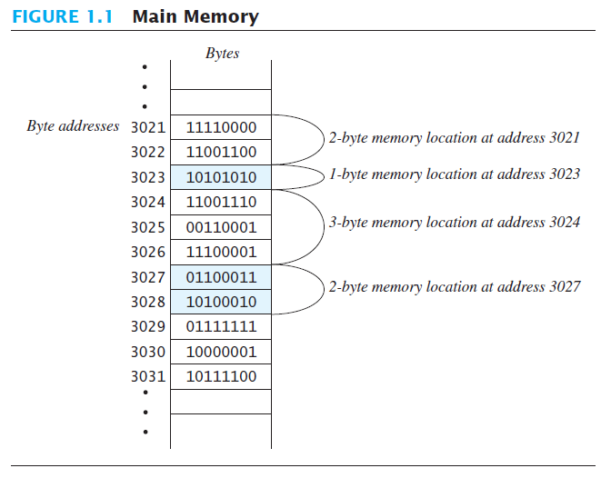
Bits & Bytes and Storing Data
A bit is a digit with a value of either 0 or 1.
A byte consists of 8 bits.
Each byte in main memory resides at a numbered location called its address.
Data of all kinds (numbers, letters, strings of characters, audio, video, even programs) are encoded and stored using 1s and 0s.
When more than a single byte is needed, several adjacent bytes are used.The address of the first byte is the address of the unit of bytes.

Slide 7
Files
Large groups of bytes in auxiliary memory are called files.
Files have names.
Files are organized into groups called directories or folders.
Java programs are stored in files.
Programs files are copied from auxiliary memory to main memory in order to be run.

Slide 8
Programs
Any thoughts on the use of the word “almost” here?
A program is a set of instructions for a computer to follow.
We use programs almost daily (email, word processors, video games, bank ATMs, etc.).
Following the instructions is called running or executing the program.
Notes:
programs are everywhere

Slide 9
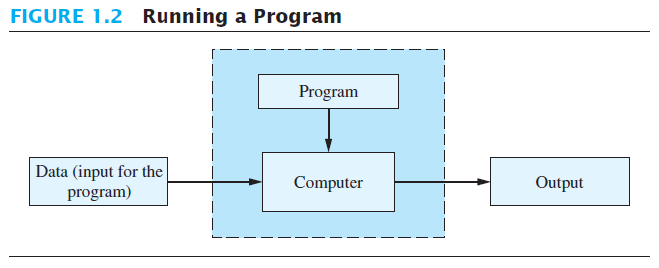
Running a program: Input and Output
This is how we think of running a program:
Strictly speaking, the program is also an input to the computer in addition to the data needed by the program
The output is the result(s) produced by following the instructions in the program.

Slide 10
The Operating System (OS)
The operating system is a supervisory program that oversees the operation of the computer.
The operating system retrieves and starts other programs for you.
Well-known operating systems including: Microsoft Windows, Apple’s Mac OS, Linux, and UNIX.

Slide 11
Programming Languages
High-level languages are relatively easy to use
Java, C#, C++, Visual Basic, Python, Ruby.
computer hardware does not understand high-level languages.
A compiler translates a program from a high-level language to a low-level language the computer can run.

Slide 12
Program Solving Cycle
Solving a program goes through the following main steps:
Analysis: Outline the solution requirements
Design an appropriate algorithm or a flowchart.
Code the solution in a high programming language (such as Java)
Compile the code into machine language. Verify that the program works:
If there is an error, correct it by going to step 3.
If there is no error, proceed to step 5.
Run the program. Verify the results:
If the output does not give the required results, go to step 1.
If the output matches the required result, you are done.

Slide 13
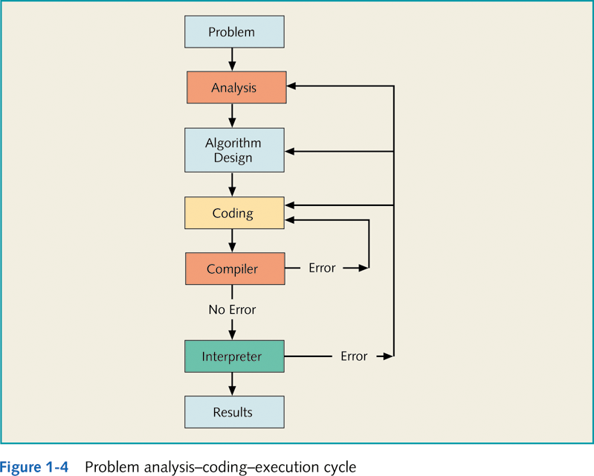
Program Solving Cycle (cont’d)
Syntax Error
Logical or Run-time Error

Slide 14
Program Compilation
The compiler:
is a software that checks the correctness of the source code according to the language rules
If it produces an error, this is called a syntax error.
it translates the source code into a machine code if no errors were found.

Slide 15
Platform dependency
Machine code depends on the computer hardware: we say that the compiled version is platform-dependent. For example:
a program compiled on a machine that works under the Windows OS, cannot run on another machine that works under the MAC OS.
In this case, the program should be re-compiled under the MAC operating system.
However, Java is platform-independent:
In other words, a Java program that is compiled under the Windows OS can run under the MAC OS without being re-compiled.

Slide 16
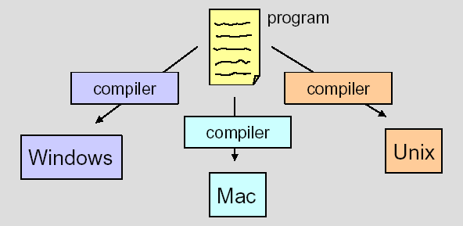
Program Compilation (cont’d)
Platform-Dependent Compilation
Note:
Most compilers are very large programs that are expensive to produce

Slide 17
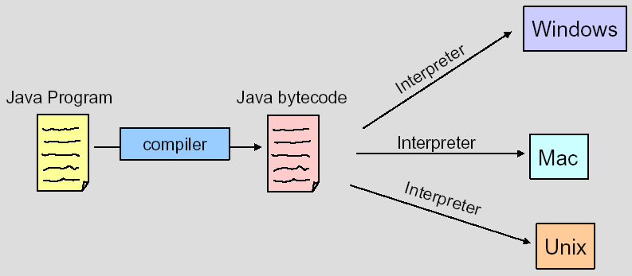
Java Programs’ Compilation
First, the Java compiler translates
the source code (with extension “.java”) into
bytecode (with extension “.class”)
Then, a Java Interpreter translates
the bytecode into machine code.
The same bytecode can run on any computer installed with a Java Interpreter
“Hello.java”
“Hello.class”
Notes:
Interpreters are cheaper and smaller than compilers

Slide 18

Java Byte-Code
The Java compiler does not translate a Java program into machine language for a particular computer.
Instead, it translates a Java program into byte-code.
Byte-code is the machine language for a hypothetical computer (or interpreter) called the Java Virtual Machine.
Source Code
Bytecode
Java VM or JVM = Java Virtual Machine
Notes:
Interpreters are cheaper and smaller than compilers

Slide 19
Java Byte-Code
A byte-code program is easy to translate into machine language for any particular computer.
A program called an interpreter translates each byte-code instruction, executing the resulting machine-language instructions on the particular computer before translating the next byte-code instruction.
Most Java programs today are executed using a Just-In-Time or JIT compiler in which byte-code is compiled as needed and stored for later reuse without needing to be re-compiled.

Slide 20
Compiling, Interpreting, Running
Use the compiler to translate the Java program into byte-code (done using the javac command).
Use the Java virtual machine for your computer to translate each byte-code instruction into machine language and to run the resulting machine-language instructions (done using the java command).
Notes:
Students will be using JGrasp

Slide 21
Portability
The byte-code can be used on any computer with a byte-code interpreter and without a need to recompile.
Byte-code can be sent over the Internet and used anywhere in the world.
This makes Java suitable for Internet applications.
“Hello.java”
“Hello.class”

Slide 22
Class Loader
A Java program typically consists of several pieces called classes.
Each class may have a separate author and each is compiled (translated into byte-code) separately.
A class loader (called a linker in other programming languages) automatically connects the classes together.

Slide 23
